Slide 1

The Gaming Top 40
Harley Drake
u3144550

Slide 2
Video Game Sales
What are the top best selling video Games?
What are the best selling games on different consoles?
What are the best selling games of each decade from the 1980s to the 2010s and by year
How much has the gaming industry grown?

Slide 3
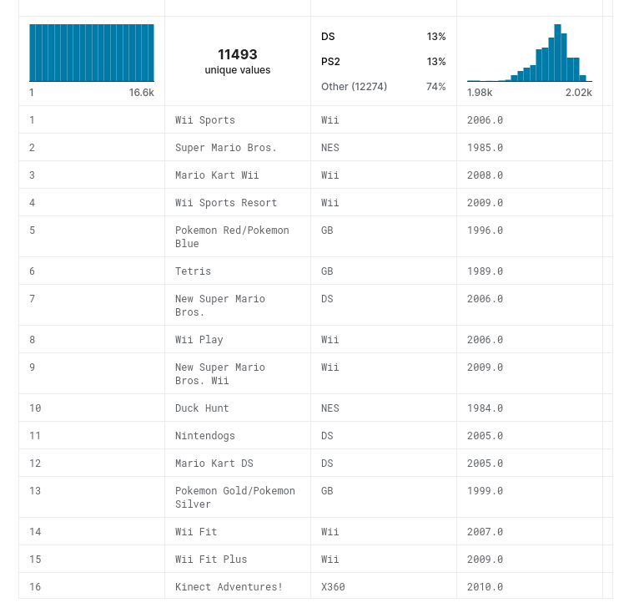
Dataset
Over 15,000 titles with sales in various regions
Only up to 2016
Minimal errors in set up
Some titles missing

Slide 4

Django
Easy to deploy
Easy to customise
Very robust
Instantly accessable

Slide 5
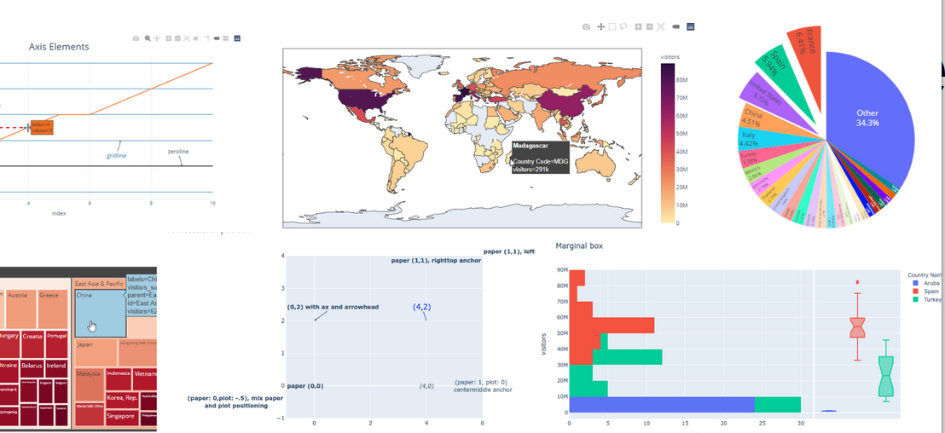

Plotly
Easy to set up
Can be embedded in HTML via django

Slide 6
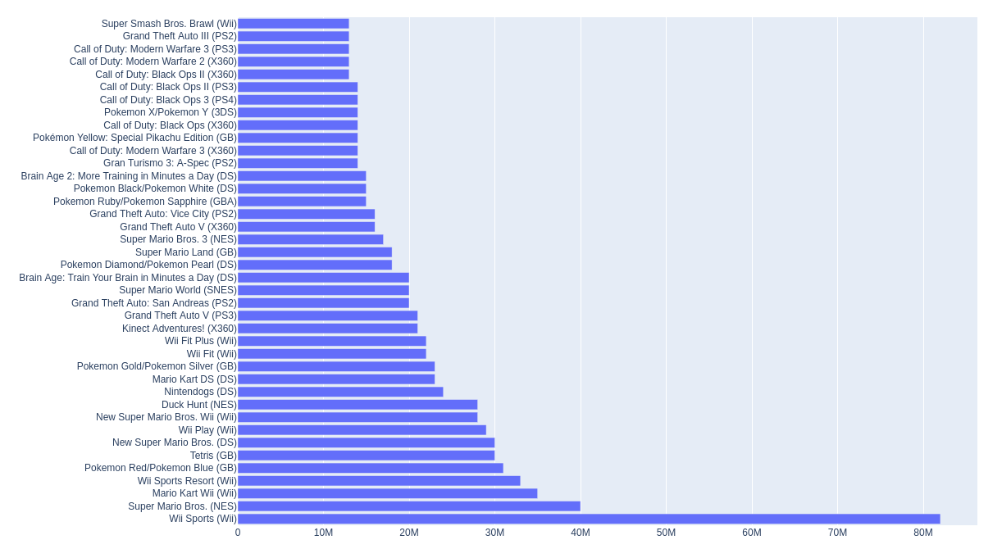
What are the best selling video Games?

Slide 7
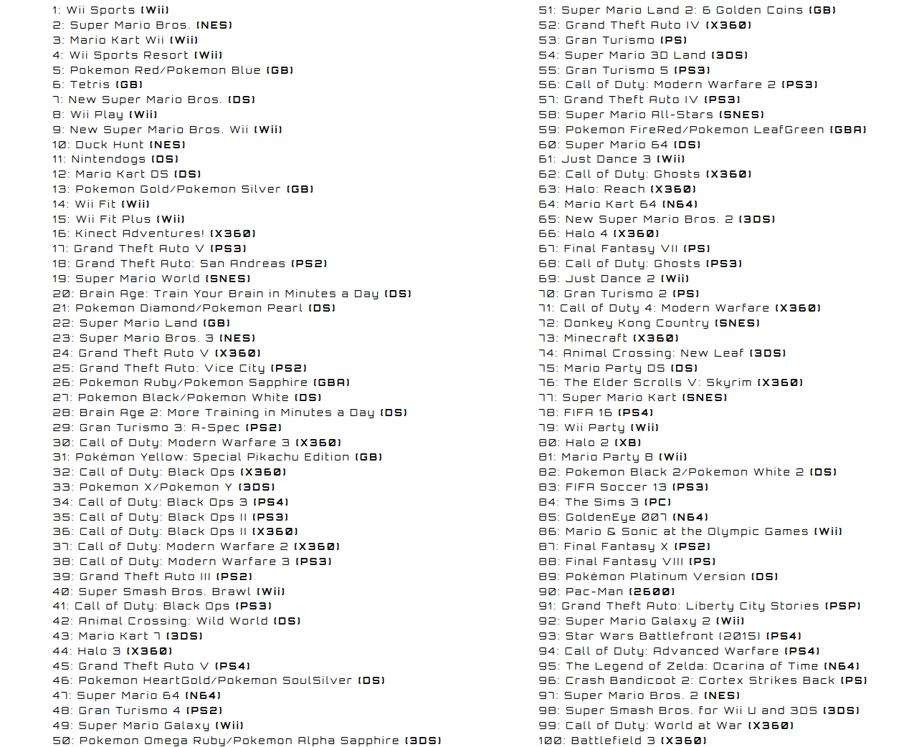

Slide 8
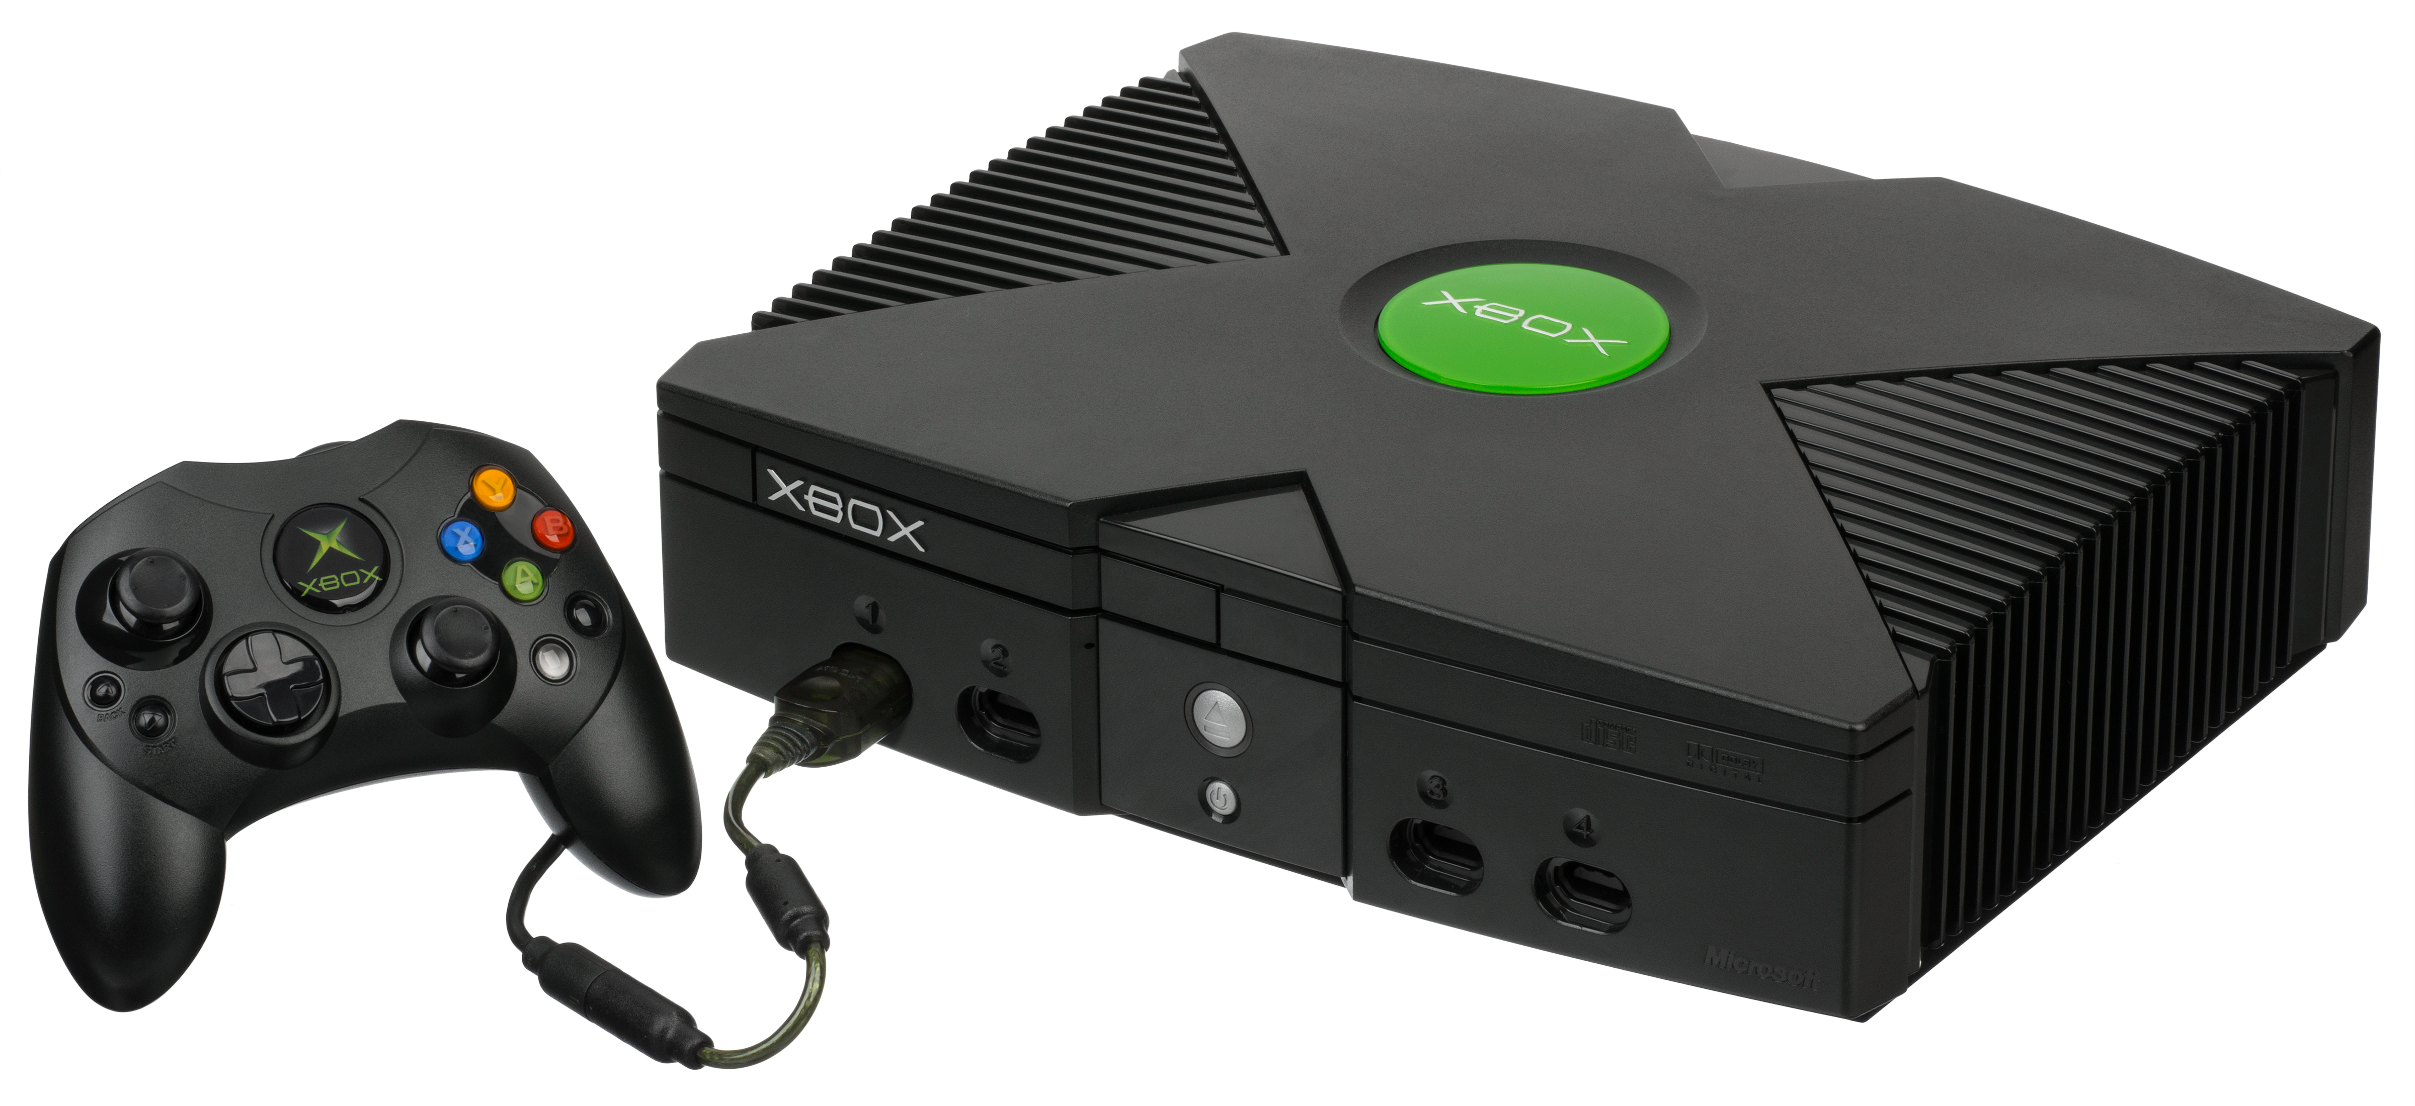
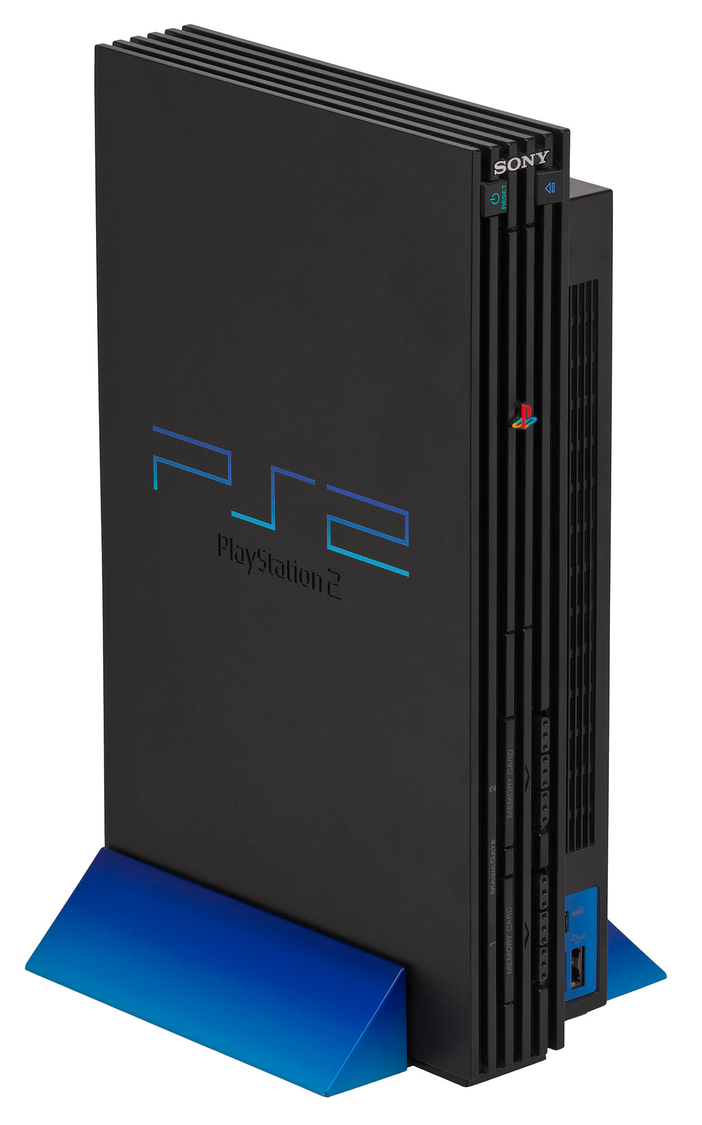
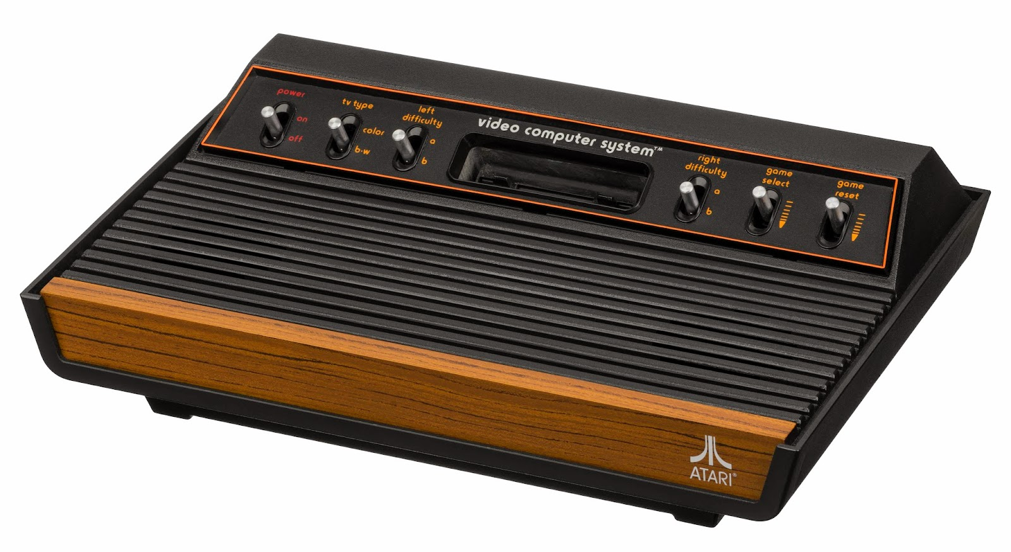
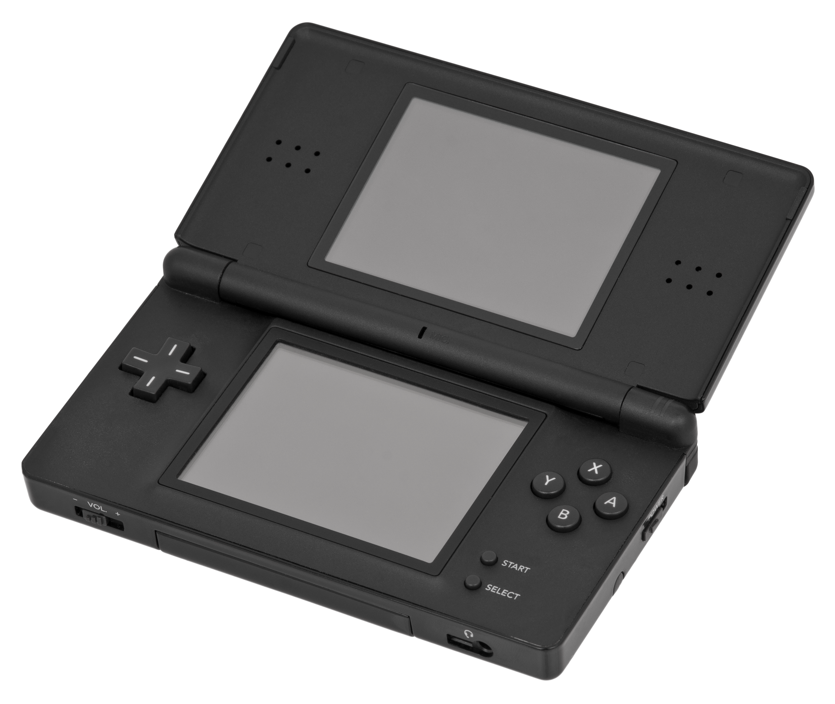
Best Selling game on different Consoles?
Xbox
Playstation 2
Nintendo DS
Atari 2600

Slide 9
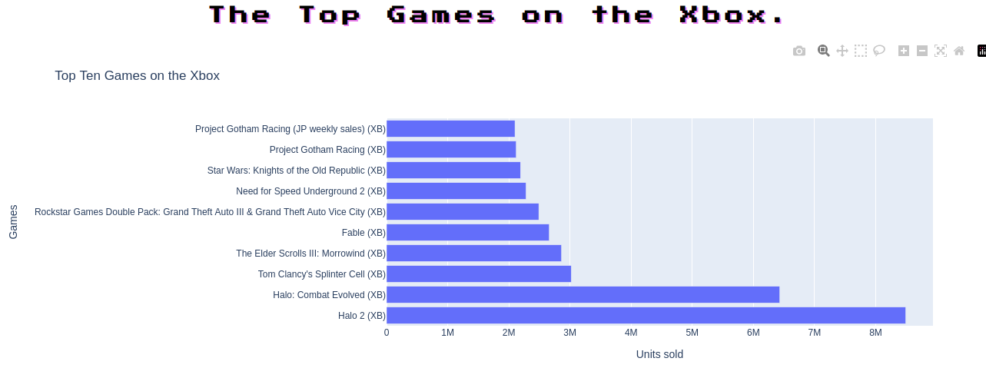
Xbox

Slide 10
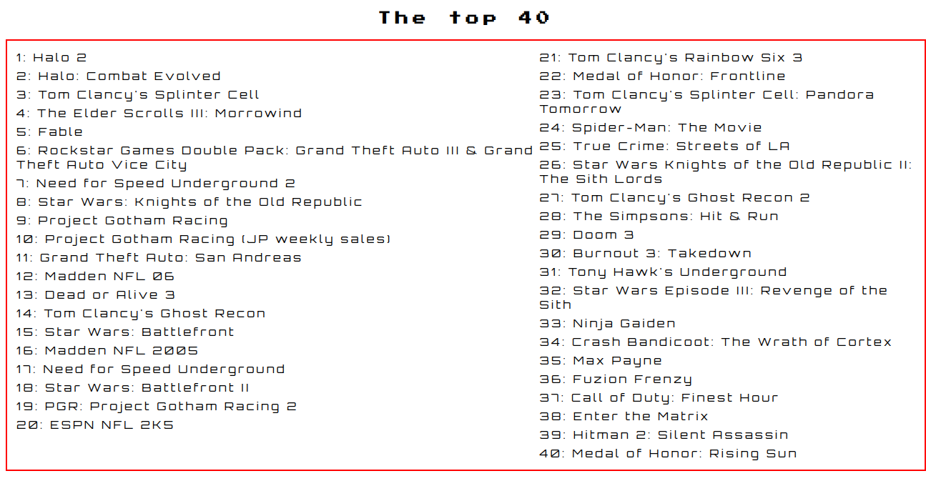

Slide 11
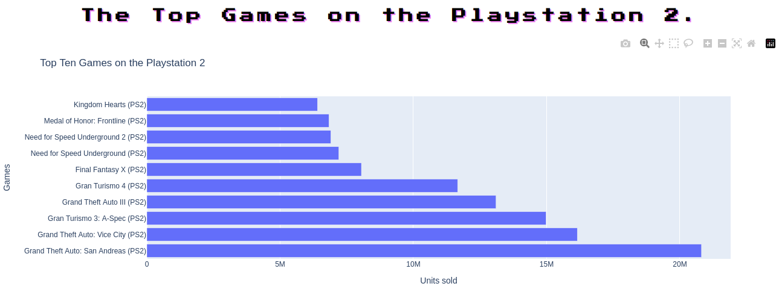
Playstation 2

Slide 12
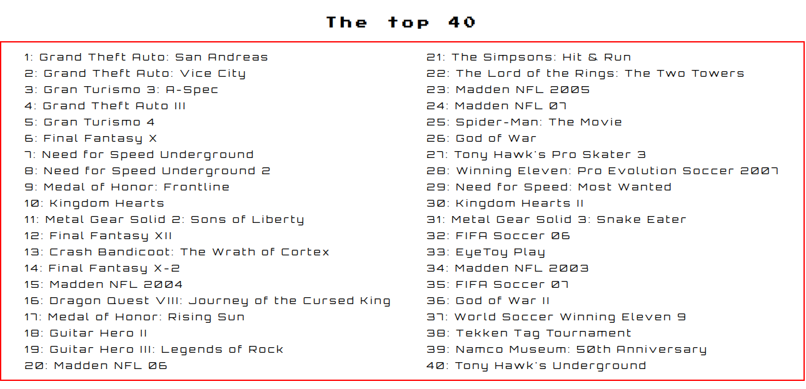

Slide 13
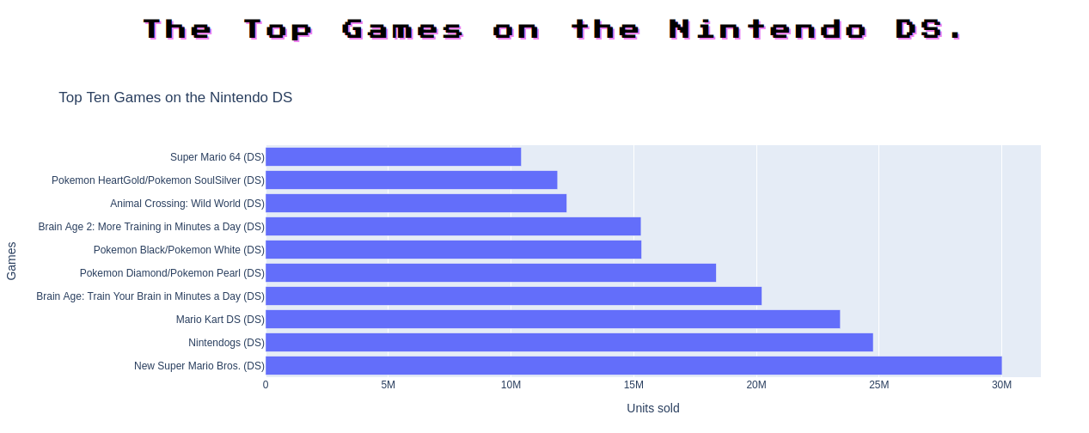
Nintendo DS

Slide 14
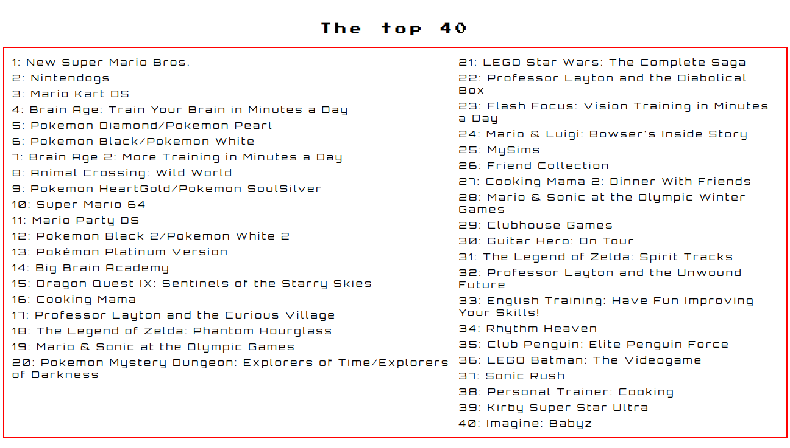

Slide 15
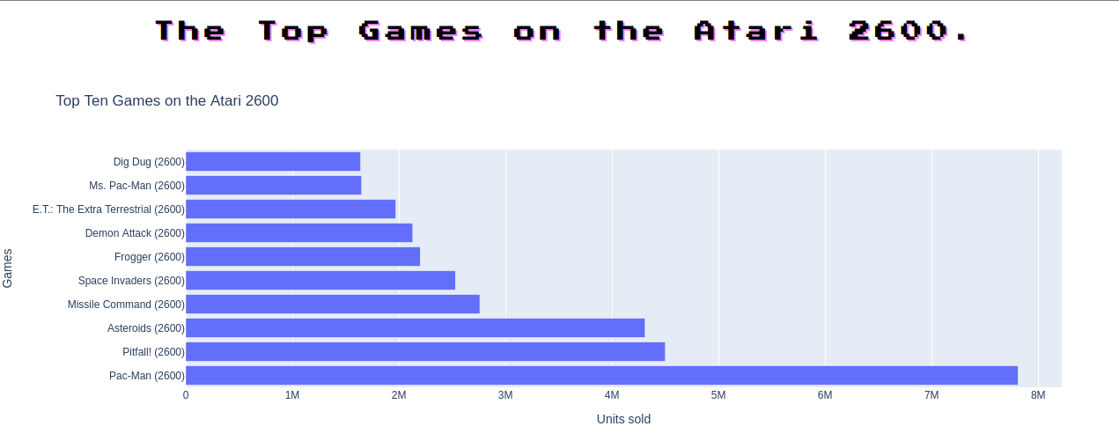
Atari 2600

Slide 16
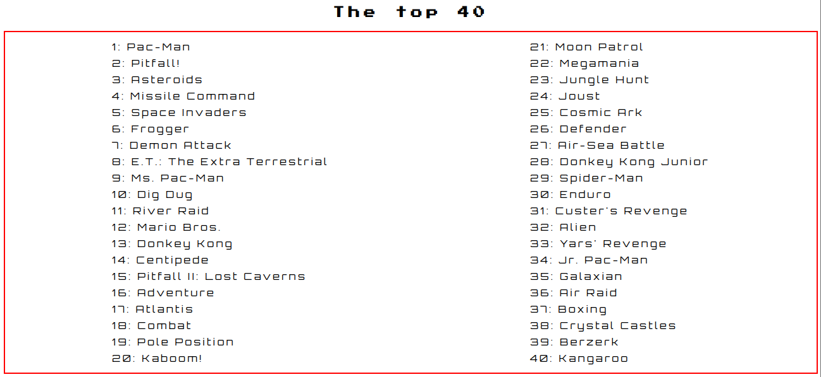

Slide 17

Video Games by decade and years

Slide 18
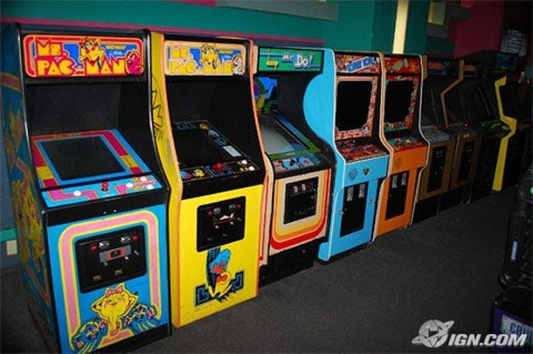
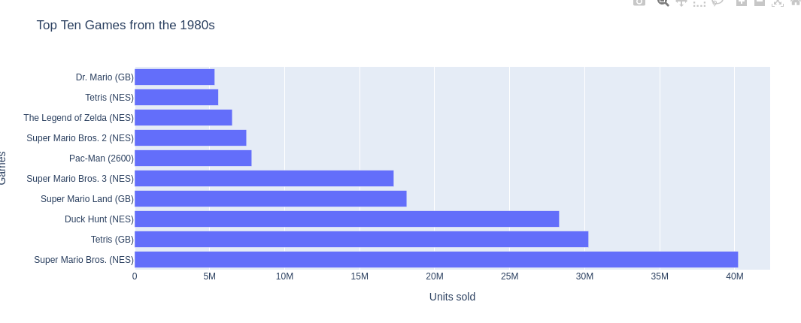
1980s

Slide 19

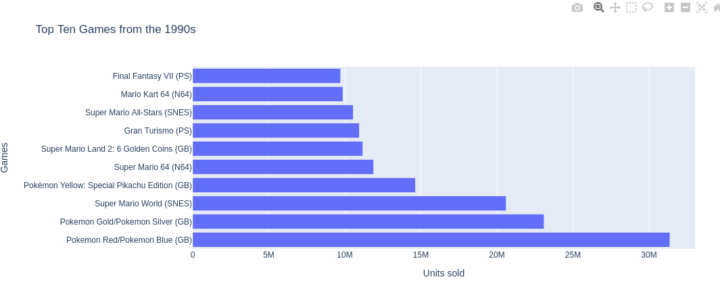
1990s

Slide 20

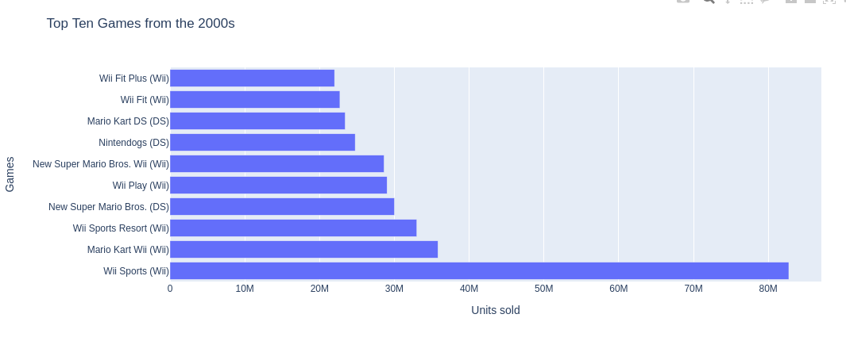
2000s

Slide 21

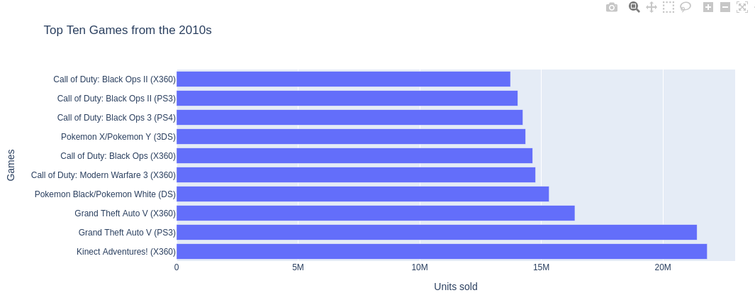
2010s

Slide 22
By Years?

Slide 23

Video Game Sales over 3 decades

Slide 24
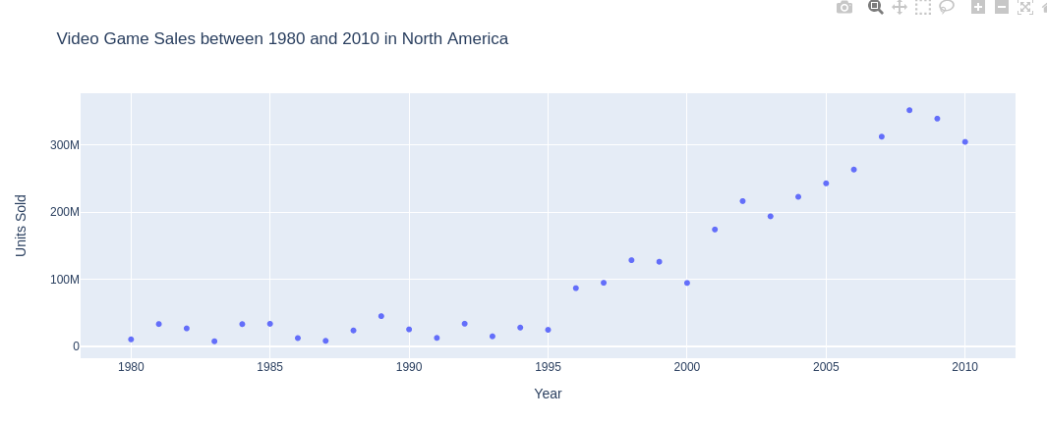
North America

Slide 25
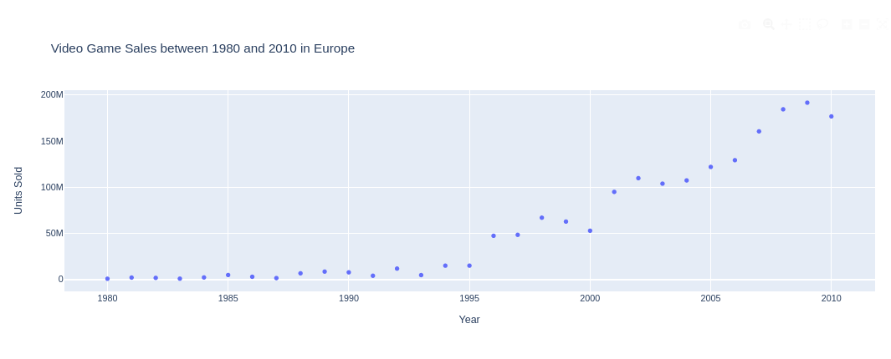
Europe

Slide 26
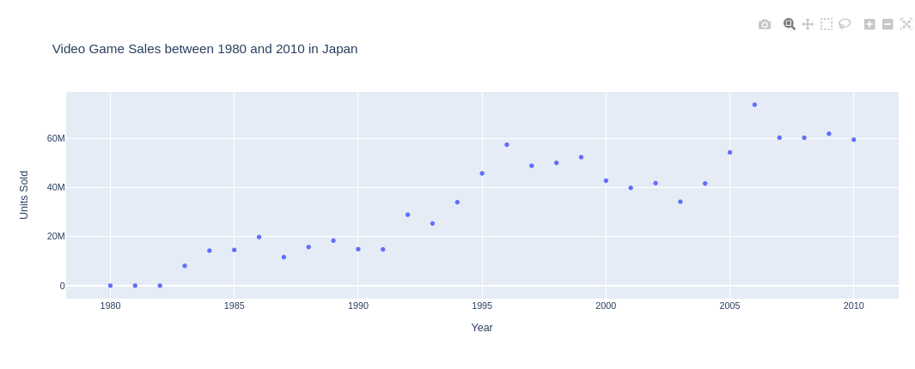
Japan

Slide 27
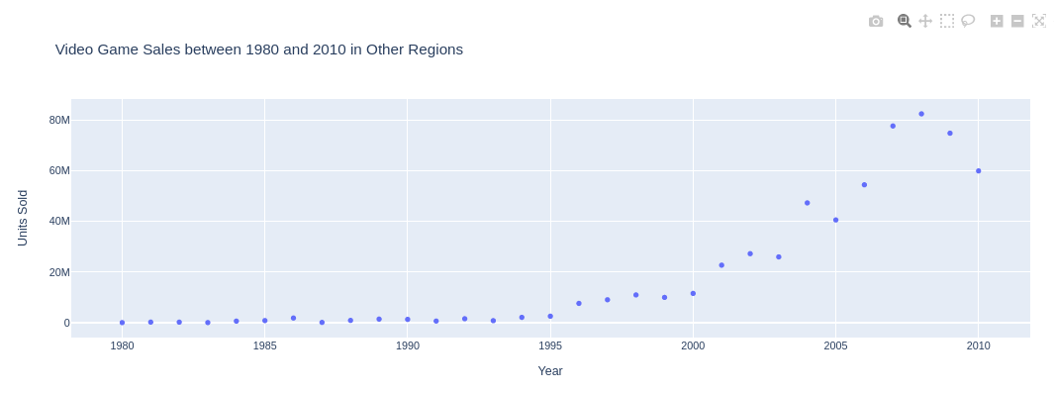
Other (here)

Slide 28
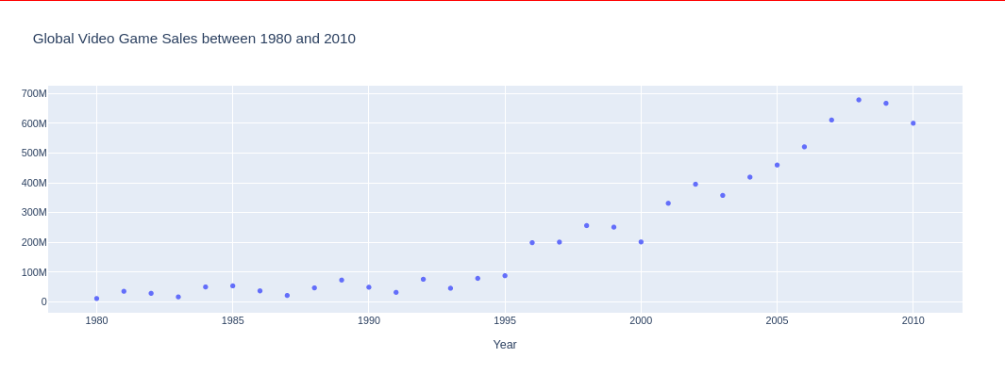
Global Sales

Slide 29

Final Thoughts
Sales by console, genre, franchise
Search by title
Increase the sample space

